Slide 1




The course notes are partly based on the Machine learning course presented by Andrew Ng at Stanford University and the original can be found at https://www.coursera.org/course/ml b
e.
All materials without annotations or marks are copyrighted by their copyright owner.
All the codes and modified slides are available at Github & OSChina
The project homepage:
https://github.com/sunzuolei/ml
https://git.oschina.net/samuel/ml
The Git repository:
https://github.com/sunzuolei/ml.git
https://git.oschina.net/samuel/ml.git

Slide 2
Linear regression
Nonlinear regression
Logistic regression
Neural network
Regularization

Slide 3
COST FUNCTION
GRADIENT
GRADIENT DECENT
Regularization

Slide 4
COST FUNCTION
GRADIENT
fminunc
fmincg
Regularization

Slide 5
There is often a huge difference between…

Slide 6


Those who really know how to powerfully and effectively apply these algorithm
Those who don’t really understand how to apply these algorithms and can end up wasting a lot of
time trying things out that don't really make sense

Slide 7

Those who really know how to powerfully and effectively apply that algorithm
Those who don’t really understand how to apply these algorithms and can end up wasting a lot of
time trying things out that don't really make sense
How to choose the most promising avenues?

Slide 8
Machine learning algorithms heavily rely on parameters
Model structure
Regularization factor
Training data
Number of iteration
Optimization algorithm

Slide 9

Deciding what to try next
Advice for applying machine learning
Machine Learning

Slide 10

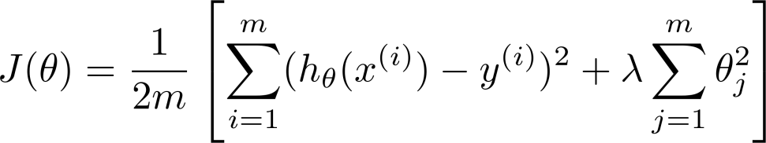
Debugging a learning algorithm:
Suppose you have implemented regularized linear regression to predict housing prices.

Slide 11

However, when you test your hypothesis on a new set of houses, you find that it makes unacceptably large errors in its predictions.
What should you try next?

Slide 12









Get more training examples

Slide 13
Get more training examples
The sad thing is I’ve seen a lot of people spend a lot of time collecting more training examples, thinking oh, if we have twice as much or ten times as much training data, that is certainly going to help. But sometimes getting more training data doesn't actually help.
--- Andrew NG

Slide 14



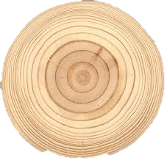
Get more training examples
Try smaller sets of features

Slide 15
Get more training examples
Try smaller sets of features
Try getting additional features
It is a huge project, it would be nice to know in advance if this is going to help before we spend a lot of time doing something like this.

Slide 16
Get more training examples
Try smaller sets of features
Try getting additional features
Try adding polynomial features
Try decreasing regularization factor
Try increasing regularization factor

Slide 17
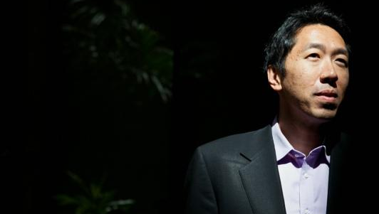
Given a menu of options, some of which can easily scale up to
six months or longer projects. Unfortunately, the most common method that people use to pick one of these is to go by gut feeling. In which what many people will do is sort of randomly pick one of these options and maybe say, “Oh, lets go and get more training data.” And easily spend six months collecting more training data or maybe someone else would rather be saying, “Well, let's go collect a lot more features in our data set.” And I have a lot of times, sadly seen people spend, you know, literally 6 months doing one of these avenues that they have sort of at random only to discover six months later that it really wasn't a promising avenue to pursue.

Slide 18
There is a simple technique that can let you very quickly rule out the things as being potentially promising things to pursue.

Slide 19
Machine learning diagnostic:
Diagnostic: A test that you can run to gain insight what is/isn’t working with a learning algorithm, and gain guidance as to how best to improve its performance.
Diagnostics can take time to implement, but doing so can be a very good use of your time.

Slide 20
Evaluating a hypothesis
Advice for applying machine learning
Machine Learning

Slide 21
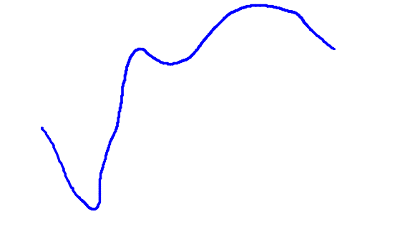
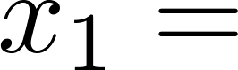
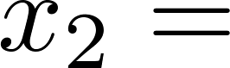
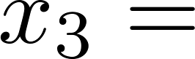
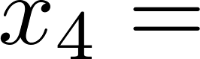
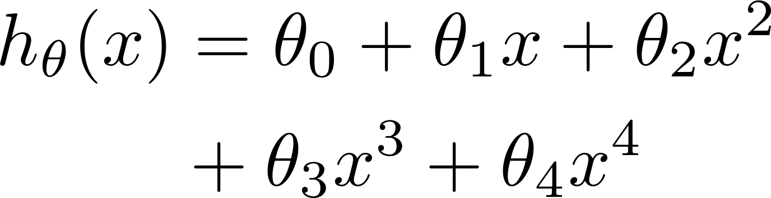
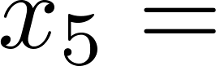
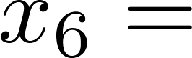
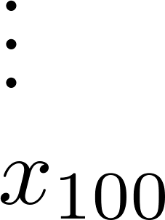
Evaluating your hypothesis
Fails to generalize to new examples not in training set.
price
size of house
no. of bedrooms
no. of floors
size
age of house
average income in neighborhood
kitchen size

Slide 22
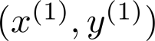
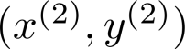
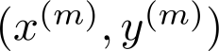
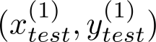
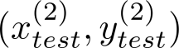
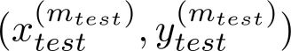
Evaluating your hypothesis
Dataset:
Size | Price
2104 | 400
1600 | 330
2400 | 369
1416 | 232
3000 | 540
1985 | 300
1534 | 315
1427 | 199
1380 | 212
1494 | 243

Slide 23

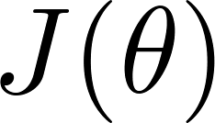
Training/testing procedure for linear regression
Learn parameter from training data (minimizing training error )
Compute test set error:

Slide 24
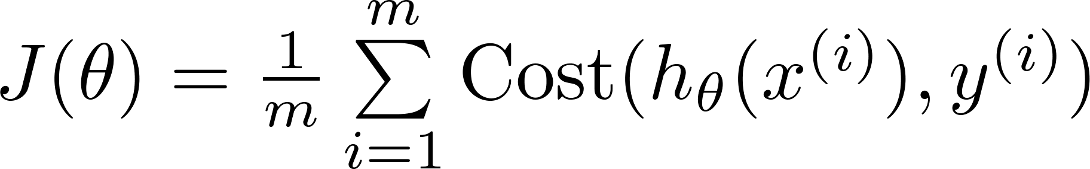
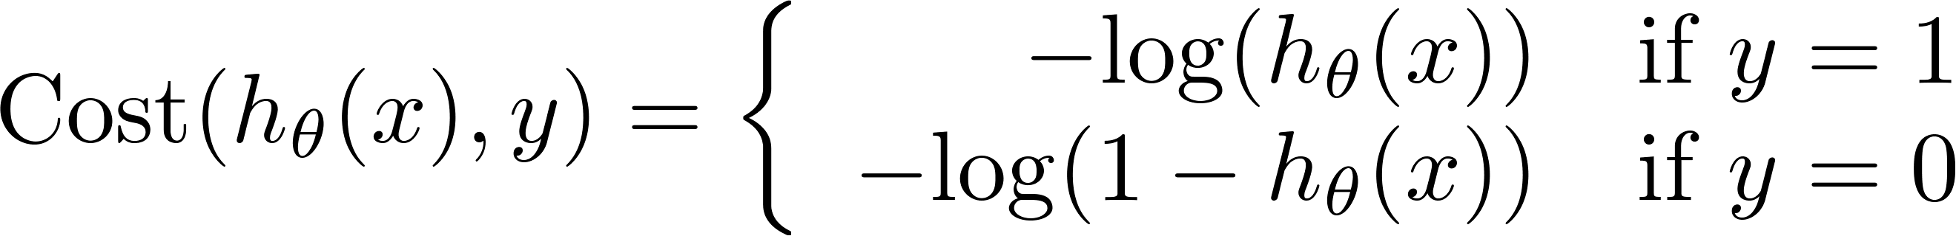
Training/testing procedure for logistic regression
Learn parameter from training data
Compute test set error:
Misclassification error (0/1 misclassification error):
Logistic regression cost function

Slide 25
Model selection and training/validation/test sets
Advice for applying machine learning
Machine Learning

Slide 26
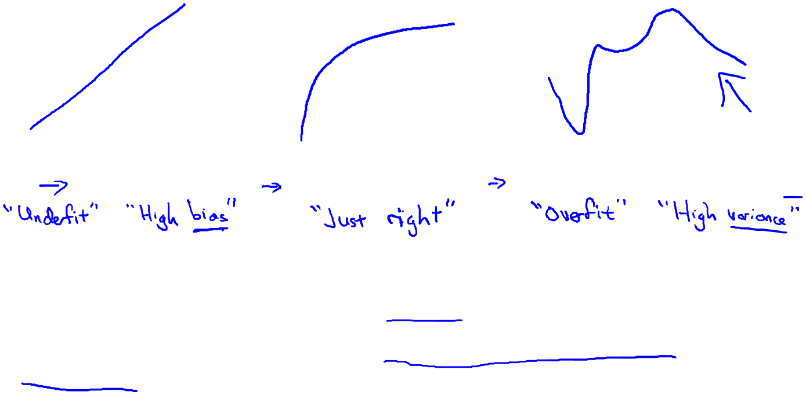
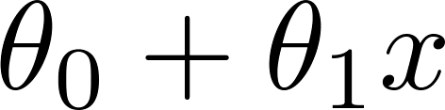
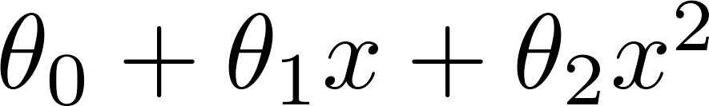
Price
Price
Price
Size
Size
Size
Under fit
JUST RIGHT
Over fit
High bias
High variance

Slide 27
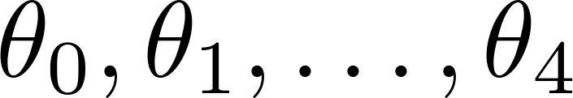
Overfitting example
Once parameters
were fit to some set of data (training set), the error of the parameters as measured on that data (the training error xxxxx) is likely to be lower than the actual generalization error.
price
size

Slide 28

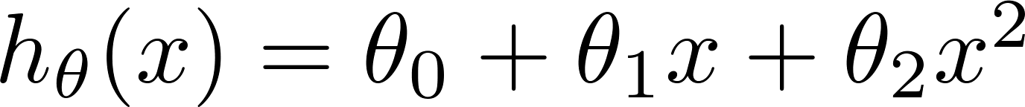
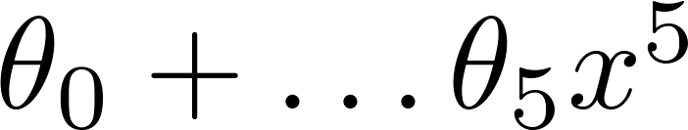
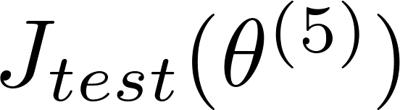
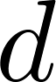
Model selection
1.
2.
3.
10.
Choose
How well does the model generalize? Report test set error .
Problem: is likely to be an optimistic estimate of generalization error. I.e. our extra parameter ( = degree of polynomial) is fit to test set.

Slide 29
We have fit the model to the test set, it is no longer fair to evaluate hypothesis on it again. So our hypothesis is likely to do better on this test set than it would be on new examples not seen before.

Slide 30
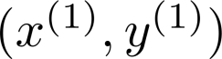
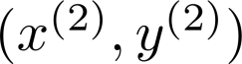
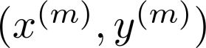
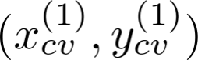
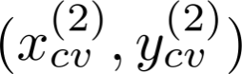
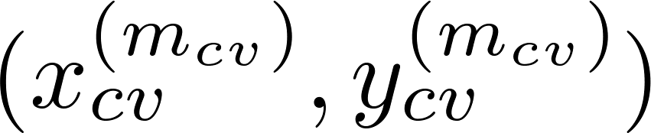
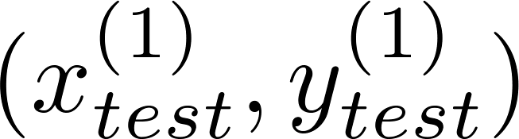
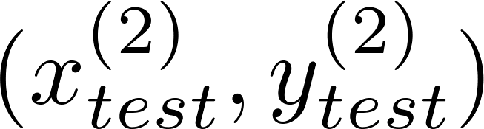
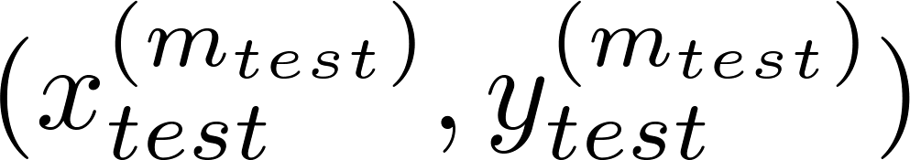
Evaluating your hypothesis
Dataset:
Size | Price
2104 | 400
1600 | 330
2400 | 369
1416 | 232
3000 | 540
1985 | 300
1534 | 315
1427 | 199
1380 | 212
1494 | 243

Slide 31
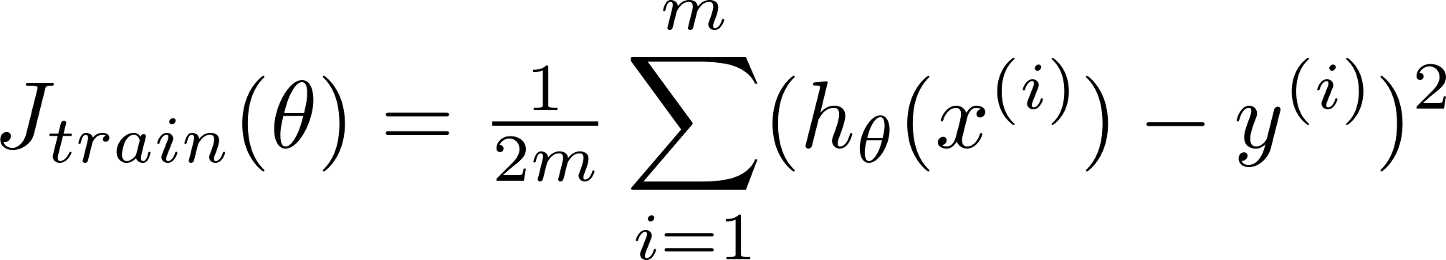
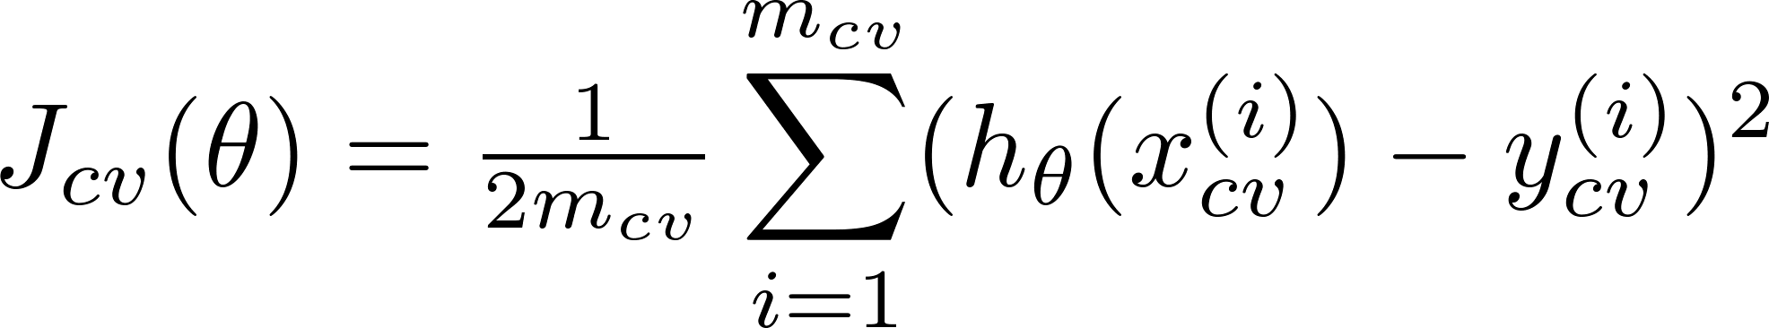
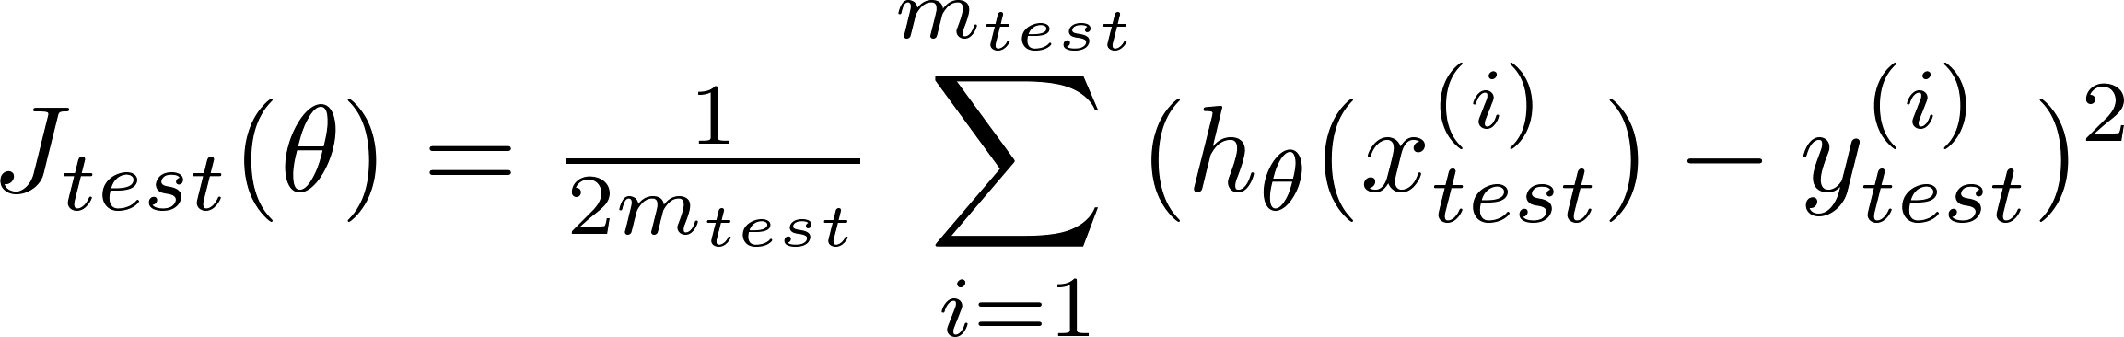
Training error:
Cross Validation error:
Test error:
errTrain(i)= computeCostReg(xTrain, yTrain, optTheta, 0);

Slide 32
%% Compute error
errTrain(power) = computeCostReg(xTrainPolyPlus, yTrain, optTheta, 0);
errCrsVal(power)= computeCostReg(xCrsValPolyPlus, yCrsVal, optTheta, 0);
errTest(power) = computeCostReg(xTestPolyPlus, yTest, optTheta, 0);

Slide 33
function optTheta = trainThetaLinearReg(x, y, lambda, numIter)
if nargin < 4
numIter = 200;
end
initTheta = zeros(size(x, 2), 1);
options = optimset('MaxIter', numIter, 'GradObj', 'on');
optTheta = fmincg(@(t)computeCostReg(x, y, t, lambda), initTheta, options);

Slide 34

Predict the amount of water flowing out of a dam using the change of water level in a reservoir.
P45

Slide 35
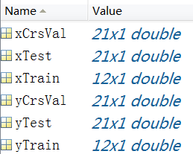
load dataChap8
P45

Slide 36
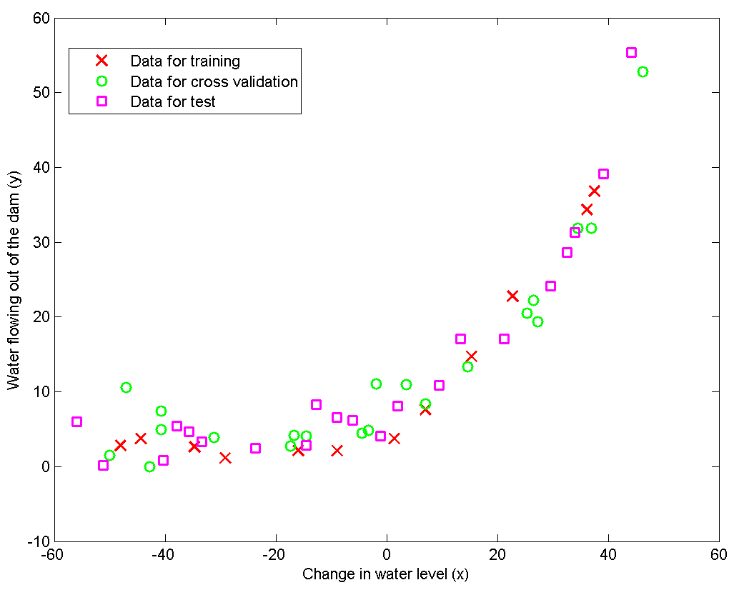

Slide 37
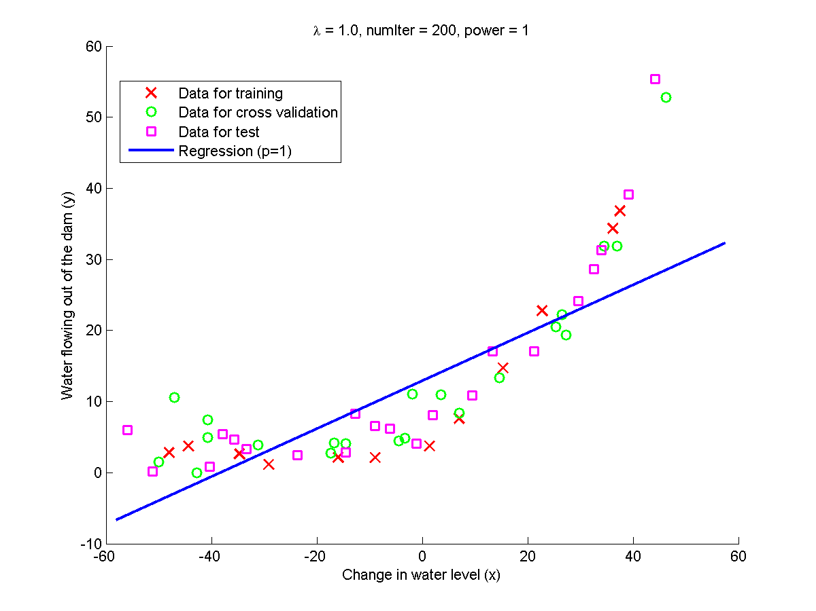

Slide 38
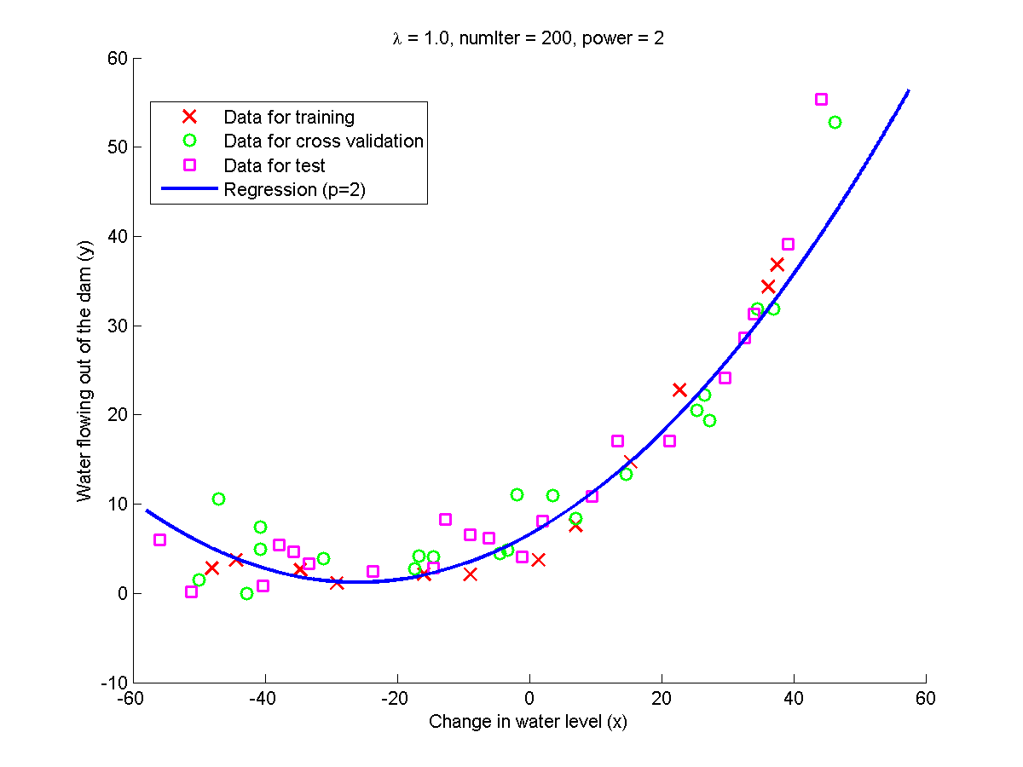

Slide 39
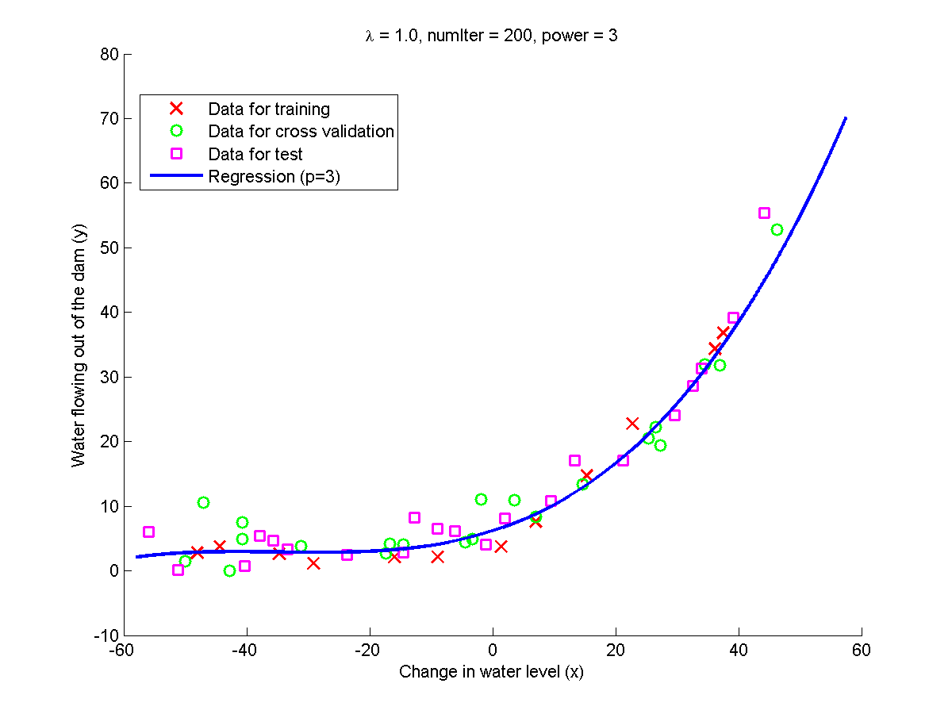

Slide 40
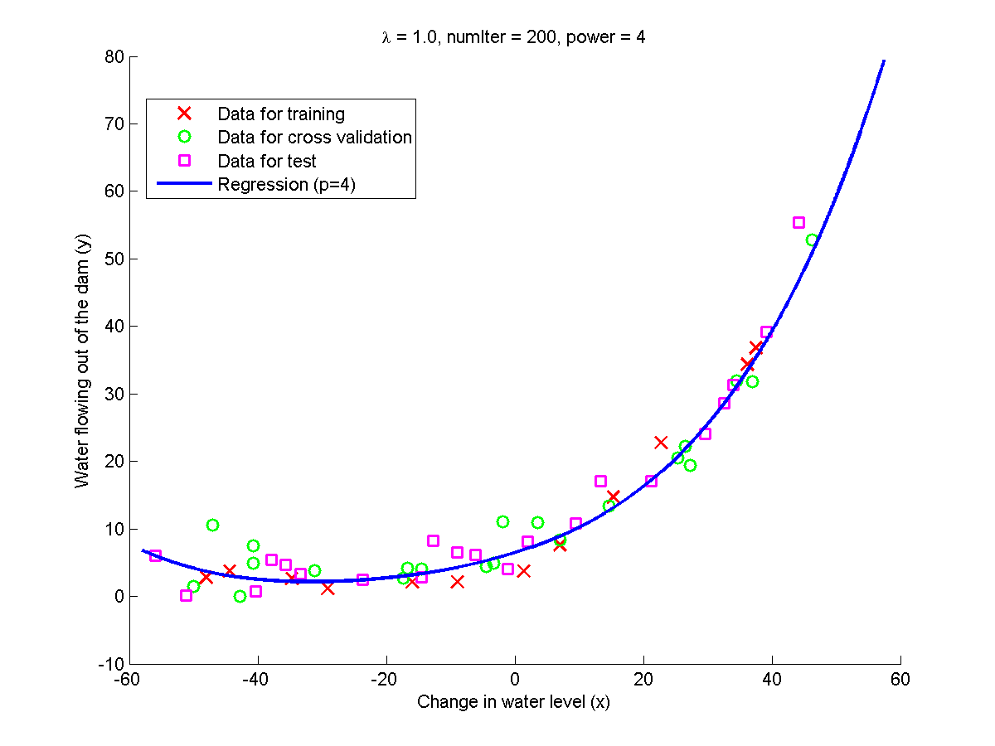

Slide 41
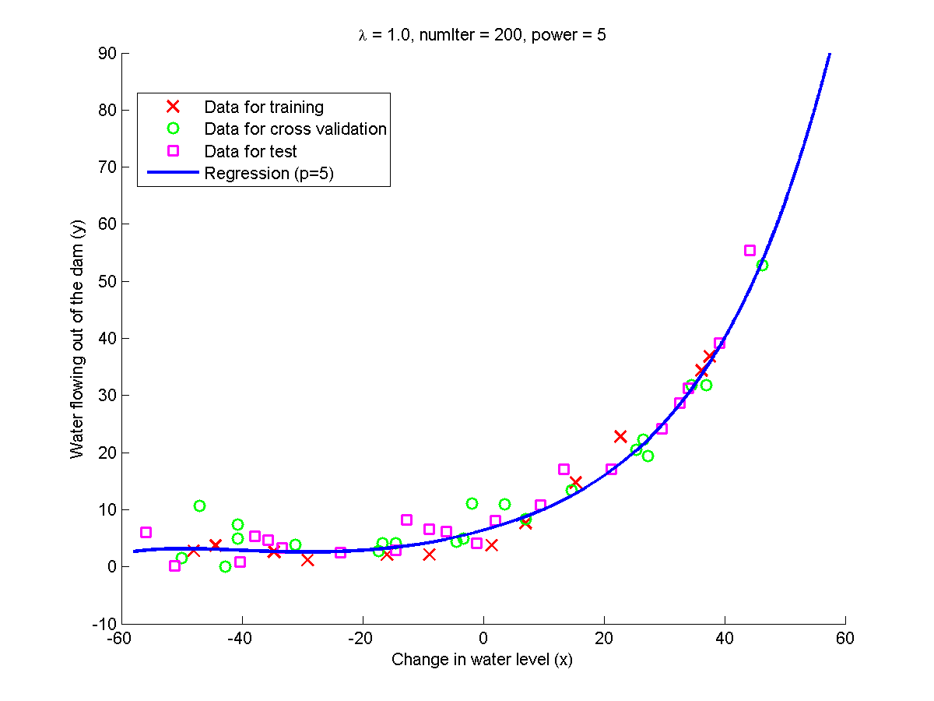

Slide 42
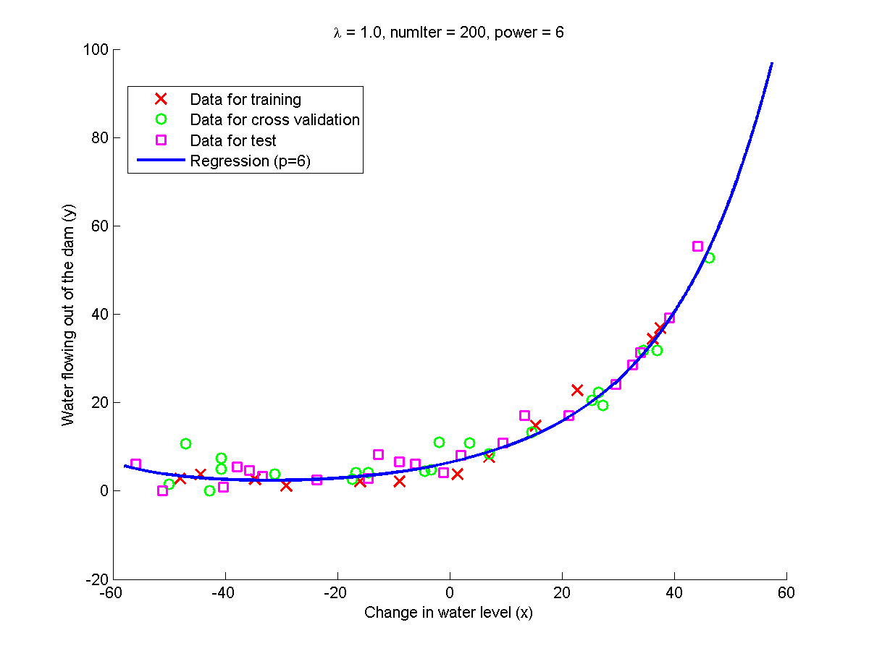

Slide 43
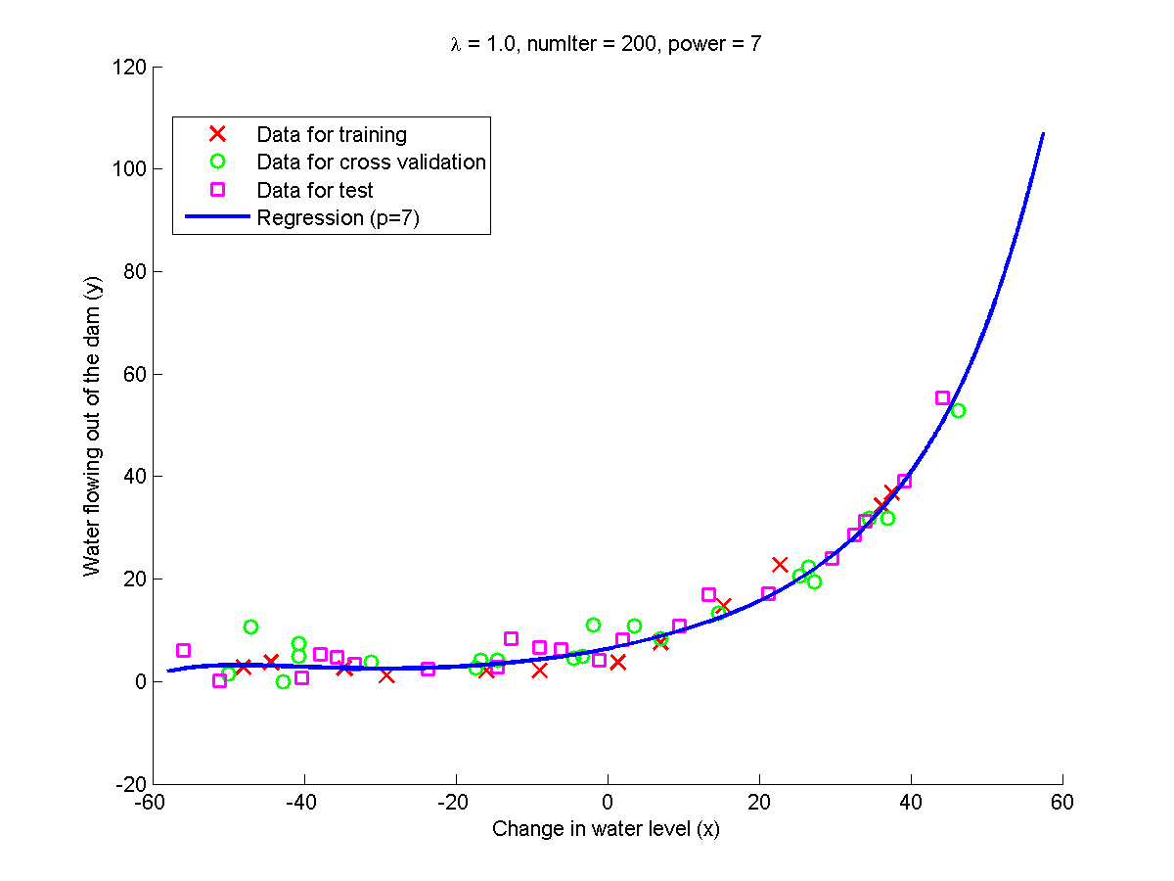

Slide 44


Slide 45


Slide 46


Slide 47


Slide 48
Diagnosing bias vs. variance
Advice for applying machine learning
Machine Learning

Slide 49

Bias/variance
Price
Price
Price
Size
Size
Size
High bias
(underfit)
“Just right”
High variance
(overfit)

Slide 50


Bias/variance
Training error:
Cross validation error:
error
degree of polynomial d

Slide 51



Diagnosing bias vs. variance
Suppose your learning algorithm is performing less well than you were hoping. ( or is high.) Is it a bias problem or a variance problem?
Underfit
Overfit

Slide 52





Bias (underfit)
will be high
error
(cross validation error)
Variance (overfit)
(training error)
will be low
degree of polynomial d

Slide 53
Learning curves
error
(training set size)

Slide 54

High bias
price
error
size
(training set size)
price
If a learning algorithm is suffering from high bias, getting more training data will not (by itself) help much.
size

Slide 55
High variance
(and small )
error
price
size
(training set size)
price
If a learning algorithm is suffering from high variance, getting more training data is likely to help.
size

Slide 56
P46
Diagnosing bias and variance based on learning curve

Slide 57
function [errTrain, errCrsVal] = learnCurveLinearReg(x, y, xCV, yCV,lambda, numIter)
for i = 1 : m
xTrain = x(1 : i, :);
yTrain = y(1 : i, :);
%% Train theta
optTheta = trainThetaLinearReg(xTrain, yTrain, lambda, numIter);
%% Compute error
errTrain(i) = computeCostReg(xTrain, yTrain, optTheta, 0);
errCrsVal(i) = computeCostReg(xCV, yCV, optTheta, 0);
end

Slide 58

Both the train error and cross validation error are high when the number of training examples is increased. This reflects a high bias problem in the model, the linear regression model is too simple and is unable to fit our dataset well.
Underfit
High bias

Slide 59

The training error is low, but the cross validation error is high. There is a gap between the training and cross validation errors, indicating a high variance problem.
Overfit
High variance

Slide 60


Slide 61
Regularization and bias/variance
Advice for applying machine learning
Machine Learning

Slide 62




Linear regression with regularization
Model:
Price
Price
Price
Size
Size
Size
Large xx
High bias (underfit)
Intermediate xx
“Just right”
Small xx
High variance (overfit)

Slide 63
Choosing the regularization parameter

Slide 64








Choosing the regularization parameter
Model:
Try
Try
Try
Try
Try
Try
Pick (say) . Test error:

Slide 65

Bias/variance as a function of the regularization parameter

Slide 66
P47
P48
Select the regularization factor

Slide 67



Overfit
High
variance
Underfit
High
Bias

Slide 68

Overfit
High
variance
Underfit
High
Bias
Just Right

Slide 69
In practice, especially for small training sets, when you plot learning curves to debug your algorithms, it is often helpful to average across multiple sets of randomly selected examples to determine the training error and cross validation error.

Slide 70
you should first randomly select i examples from the training set and i examples from the cross validation set. You will then learn the parameters using the randomly chosen training set and evaluate the parameters on the randomly chosen training set and cross validation set. The above steps should then be repeated multiple times (say 50) and the averaged error should be used to determine the training error and cross validation error for i examples.

Slide 71

P46
P49
Re-implement learning curve generation with Monte Carlo Test (numRep = 50)

Slide 72


Slide 73


Slide 74
P47
P50
Re-implement regularization factor selecting with Monte Carlo Test (numRep = 20)

Slide 75
Deciding what to try next (revisited)
Advice for applying machine learning
Machine Learning

Slide 76
Get more training examples
Try smaller sets of features
Try getting additional features
Try adding polynomial features
Try decreasing regularization factor
Try increasing regularization factor
Fixes overfitting (high variance)
Fixes overfitting (high variance)
Fixes underfitting (high bias)
Fixes underfitting (high bias)
Fixes underfitting (high bias)
Fixes overfitting (high variance)

Slide 77
Neural networks and overfitting
“Small” neural network
(fewer parameters; more prone to underfitting)
“Large” neural network
(more parameters; more prone to overfitting)
Deep learning
Computationally cheaper
Computationally more expensive.
Use regularization ( ) to address overfitting.

